Slide 1
Vaping Prevention How, Who, What and Why?
Linda Hancock, FNP, PhD
Director, The Well

Slide 2
10 minutes
What is Vaping and ENDS?
Who is most at risk to start vaping?
What’s the best way to help prevent use?
Why are the young people here today so important in preventing vaping?

Slide 3
New vocabulary
E-cigs (also E-hookah)- the device
Scientists call them
ENDS – Electronic Nicotine Delivery Systems
Vape – it’s a noun, it’s a verb
Vapers don’t smoke, they Vape!

Slide 4
What are Electronic Cigarettes?
3 important components
Has a power source
-usually a battery.
2. Contains an electrical heating element or “atomizer.”
3. Contains a liquid stored is a reservoir that is aerosolized or “vaporized” by the heating element.

Slide 5
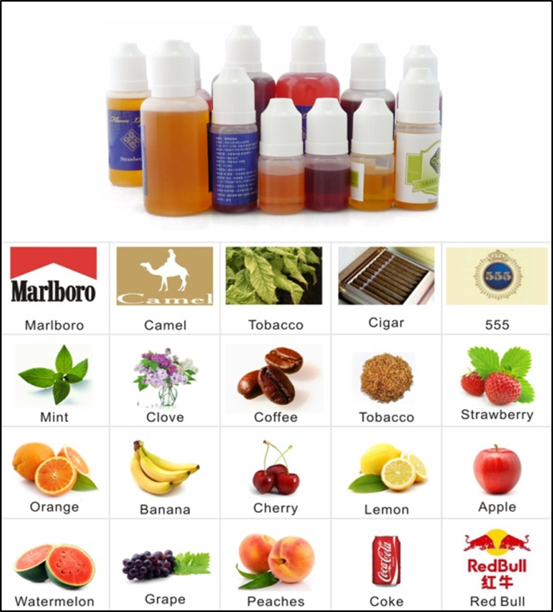
E-Liquids

Slide 6
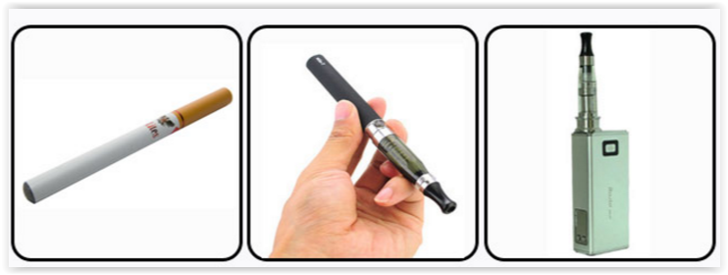
3 categories or types of e-cigs
Closed system
Disposables
“cigalikes”
Tank System
Refillable
Variable Voltage
“Mods”
(short for
Mechanical modifications)

Slide 7
Quiz
What YEAR were e-cigs first introduced in the U.S.?
2007
As of 2014, How many brands of e-cigs existed?
466 brands
As of 2014, how many flavors of e-cigs were there?
7,764 flavors

Slide 8
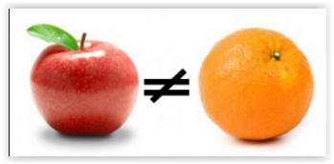
Comparing cigarettes and e-cigs
Think like a scientist, don’t make statements not supported by research

Slide 9
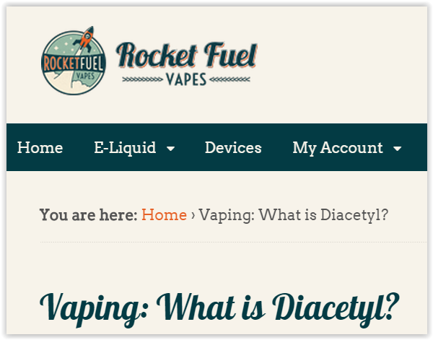
Many Unknowns Popcorn workers lungs

Slide 10
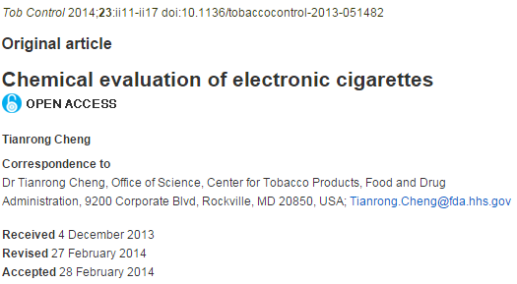
Chemicals
It is NOT just nicotine and water vapor!
nicotine
tobacco-specific nitrosamines (TSNAs)
Aldehydes
Metals
volatile organic compounds (VOCs)
Flavors
solvent carriers
tobacco alkaloids
Review of 29 articles
FINDINGS
Contents VARY within and between brands/products
contents often do not match label –
both under and over report

Slide 11
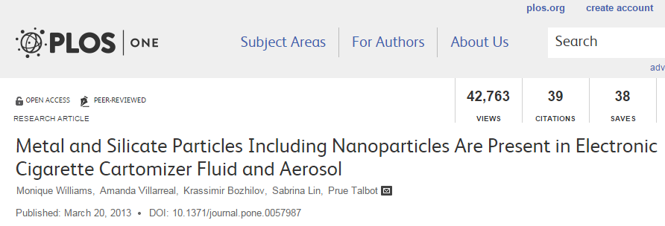
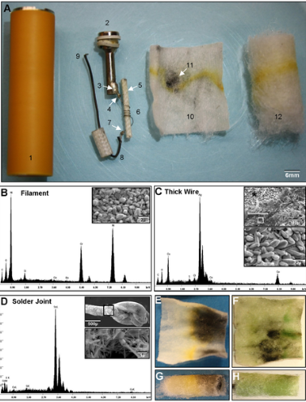
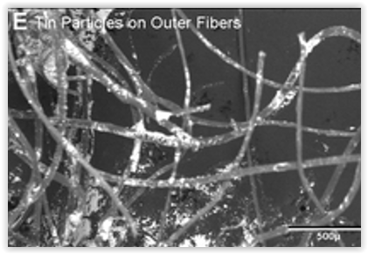
What’s in the Juice

Slide 12
In Linda’s opinion…
The biggest RISK to e-cigs is…
ADDICTION

Slide 13
Who is most at risk to start vaping?
3 Genetic Pathways of Risk
Easy access to the product
Community norms –
“everyone else” vapes

Slide 14
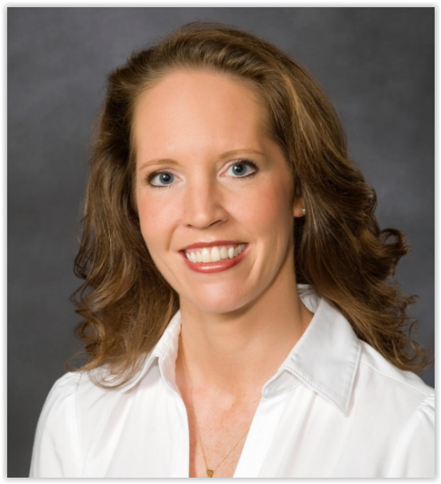
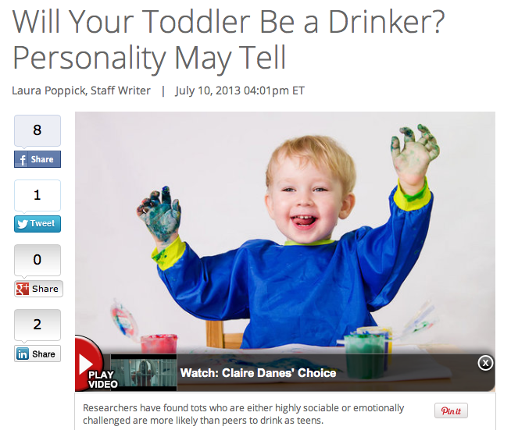
Dr. Danielle Dick
COBE Institute

Slide 15
Different Pathways of Risk for Substance Use
Externalizing: sensation-seeking, impulsivity
Internalizing: Using to cope, anxious, depressed
Physiological: Low level of response to substance
Notes:
So what we know from our research is that there are different pathways by which individuals engage in risky drinking. One factor is physiological response…Other people are more high sensation-seeking, others drink to cope. So there are very different reasons why people drink, but alcohol programming is all one size fits all. Imagine if when you went in to your primary care physician for a wellness check, instead of asking you about you’re your behavior and talking to you about your risks, they rattled off all the health risks for someone of your age. Probably not the most effective way to go. We can do better.

Slide 16
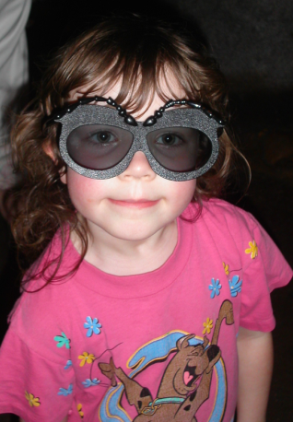
What would be the WORST possible
prevention program for
“externalizing” (Impulsive, sensation seeking) youth?

Slide 17
Internalizers are anxious & use to cope
48% of all cigarettes are sold to someone who has anxiety or depression?
Vapes?

Slide 18
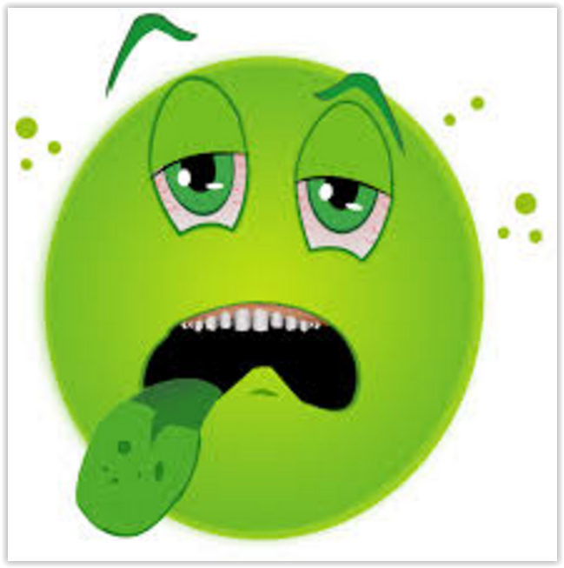
Biological Response We are all genetic snowflakes
3 in 4 can use nicotine
1 in 4 gets sick

Slide 19
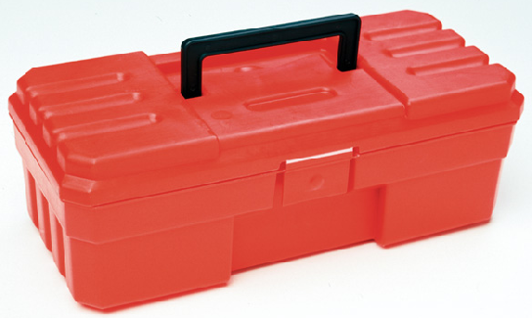
Motivational Interviewing is the MOST useful tool for prevention

Slide 20
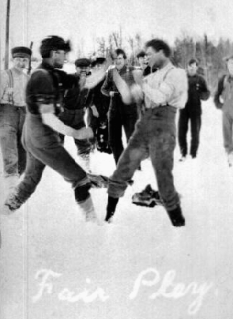
Let’s play a Game
The game is called
WIN AS MUCH AS YOU CAN!!!
Stand up
Find a partner
place right feet side by side
“shake” right hands

Slide 21
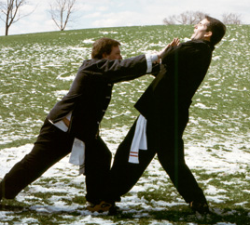
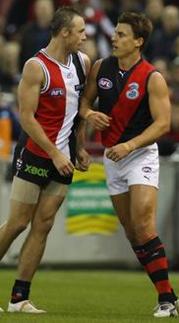
If you push…
people just naturally push back.

Slide 22
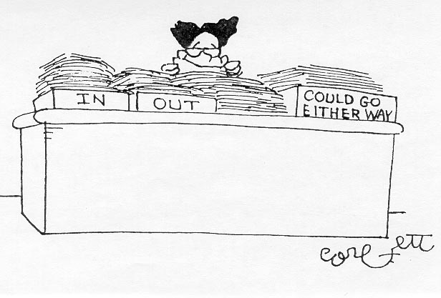
If you push

Slide 23
Health & MISPERCEPTIONS
Perception
REALITY
Overestimate
Unhealthy visible behaviors
-smokers, drunks, violence,
goofing off, credit card debt, etc.
Underestimate
Healthy less visible behaviors
-non-smokers, moderate drinkers
academic seriousness, prayer
GAP
Notes:
As some of you have said, we tend to overestimate the more unhealthy visible behaviors and underestimate the healthy less visible behaviors. What’s more fun to talk about goof off behaviors or study behaviors? (Goof off) It’s more fun to talk about last night’s party instead of Friday’s calculus test.
Prayer is underestimated but studies have shown that 60-80% of people pray on a daily or weekly basis. It is a less visible behavior…like right now you could be saying, “oh my, this lady is so boring, I think I’ll talk to God instead.”

Slide 24
Local High school April 4, 2017

Slide 25
Local High school April 4, 2017

Slide 26
Local High school April 4, 2017

Slide 27
What’s the best way to help prevent use? Why are the young people here today so important in preventing vaping?

Slide 28
If you really want to help those most at risk to start vaping…. Think like a scientist. Don’t push. Listen. Try to understand users. Then, share your own decision to not use and why you made that decision.

Slide 29
YOU CAN MAKE A DIFFERENCE & Thank you

